Slide 1

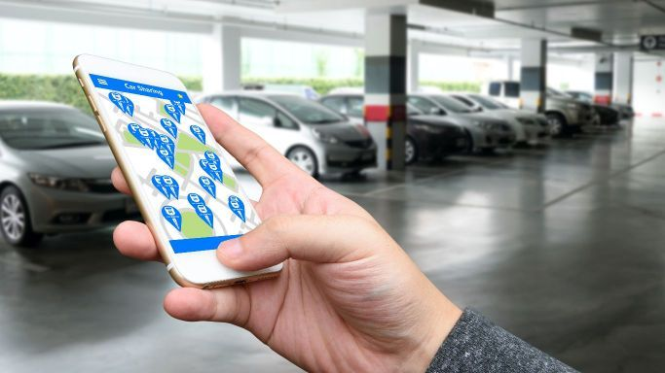

PROBLEM STATEMENT:
Requires automated parking management systems which can be used by citizens to find the available parking spots in the city/nearby area and pay parking bill for the available spots.
TEAM : SUDHANSHU AMBASTHA
PUJA KUMARI
SWECCHHA SINHA
JAYA KUMARI
SUBHAM CHOUDHARY
NIKHIL SURYA MUKHI

Slide 2
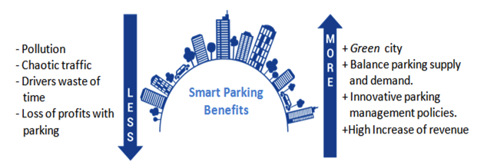
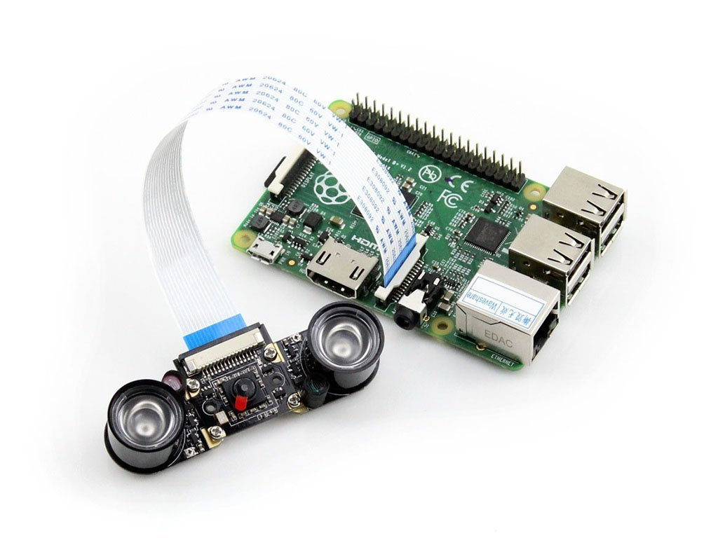
Why to go with smart parking?
Why not use sensors?
Cost efficient
Easy installation and maintenance
Orientation detection
Live tracking
Name plate detection
Scalable
Robust
1. Raspberry pi 3 module
2. Raspberry pi night vision camera
3. Apache Server
Key components of our project

Slide 3
OUR INNOVATION
REDUCED COMPUTATION BECAUSE OF PRE PROCESSING AT INTERVAL OF 5 SECONDS.
NUMBER PLATE IDENTIFICATION HELPS IN DETECTING STOLEN CARS.
SCALABLE FOR OPEN PARKING AS WELL AS STREET PARKING.
ORIENTATION DETECTION FOR IMPROPER PARKING.

Slide 4
TECHNOLOGY STACK
ANDROID APPLICATION
PHP
MYSQL DATABASE
IMAGE PROCESSING USING OPEN CV

Slide 5

Mobile
App
Server
Image processing
Pi camera monitors slot data
User is informed about available slots
Pi camera
User books a slot
1
2
3
Parking slots
User parks his car
4
5
6
7
8
9
System working

Slide 6
Features offered
1. Google map API will be used to mark the parking areas. Based on the GPS coordinate, the user can select a most appropriate
available parking slot to park his vehicle . Also navigation will be provided to the app user to find the spot .
2 . The app uses the server time to calculate the parking duration and billing is done accordingly .
3 . The Night vision cameras are used to detect the correct orientation and ensures overall elegant parking .
4 . This system provides additional security as , the Parking ID generated by the app could be used by user for real time monitoring.
Also the id would help to recognise the parked vehicle easily among the numerous other cars .
5 . Complete internal programming logic is performed on server . This reduces the chance of reluctance error in timing

Slide 7

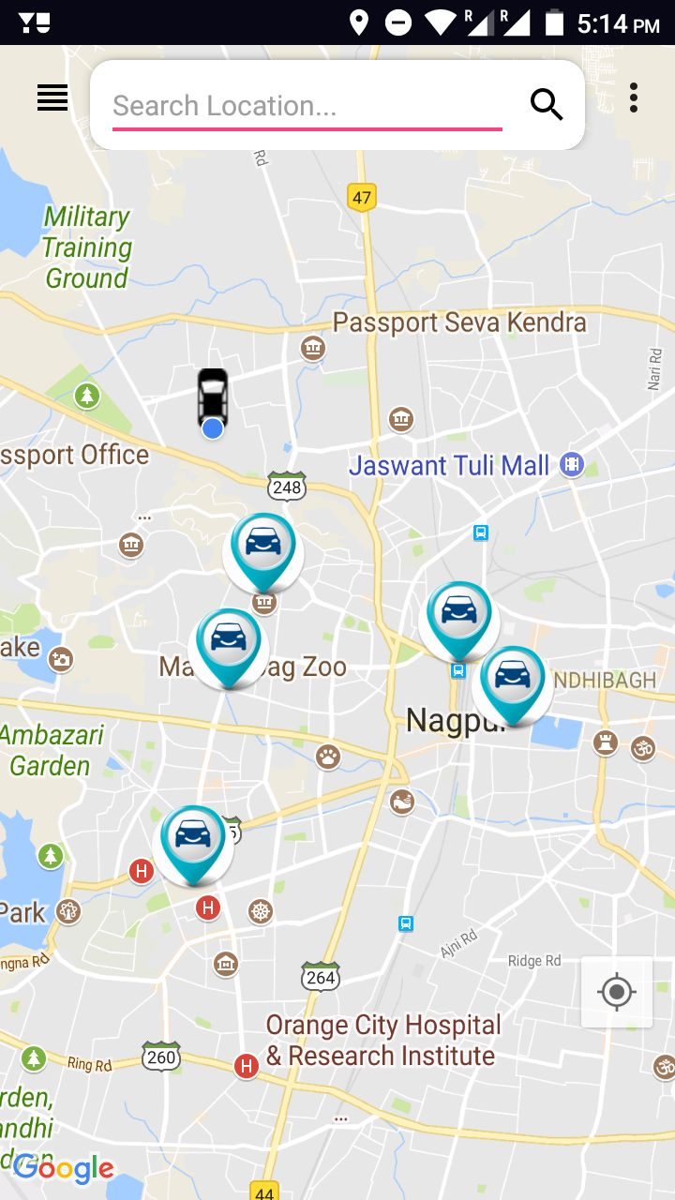
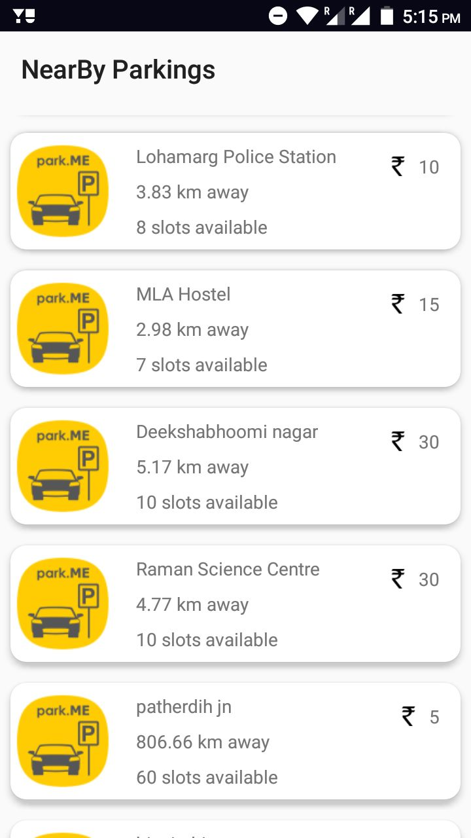

ACTIVITY FLOW

Slide 8
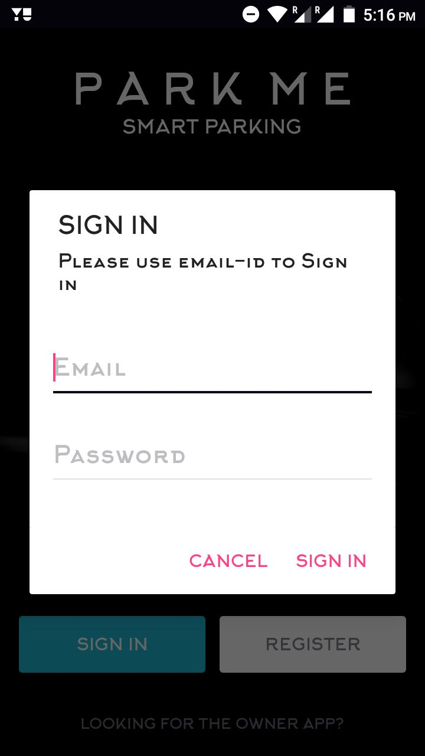
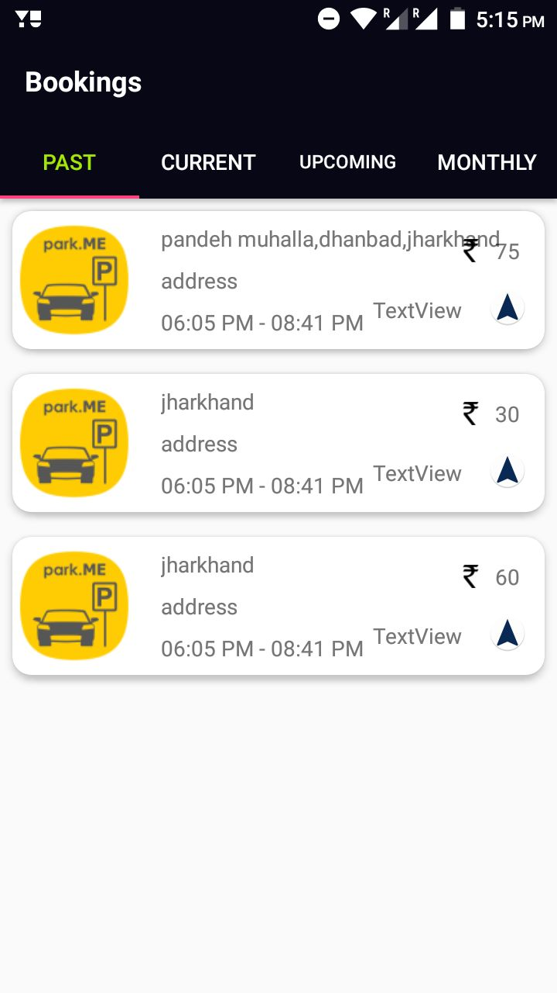

Slide 9
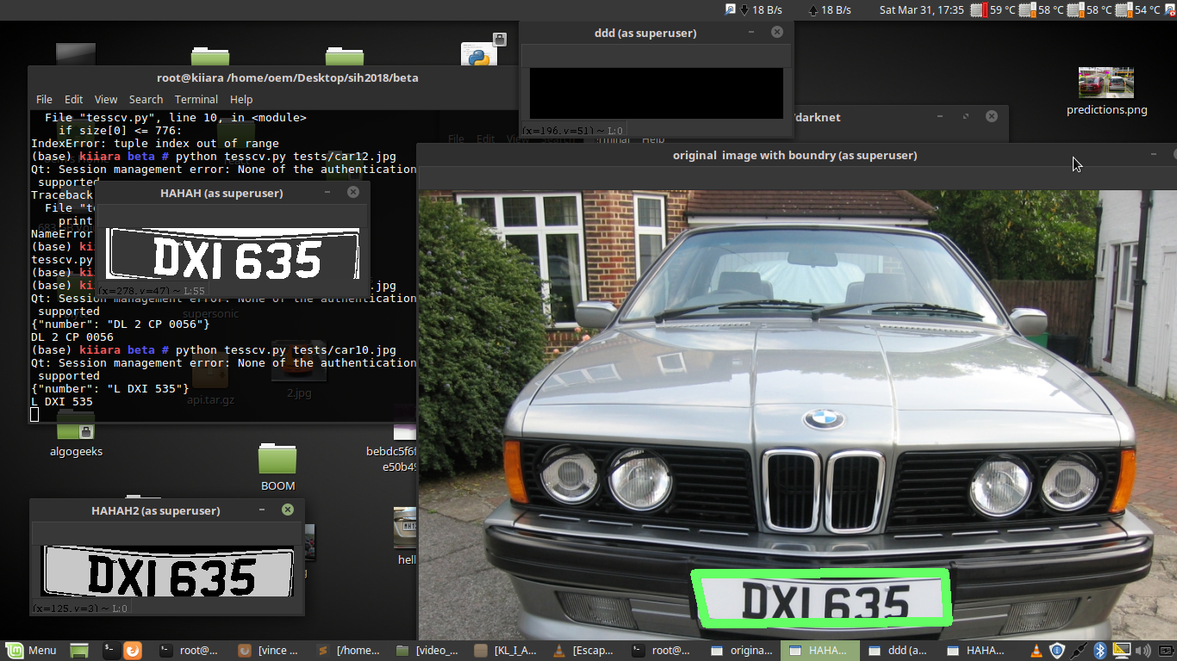
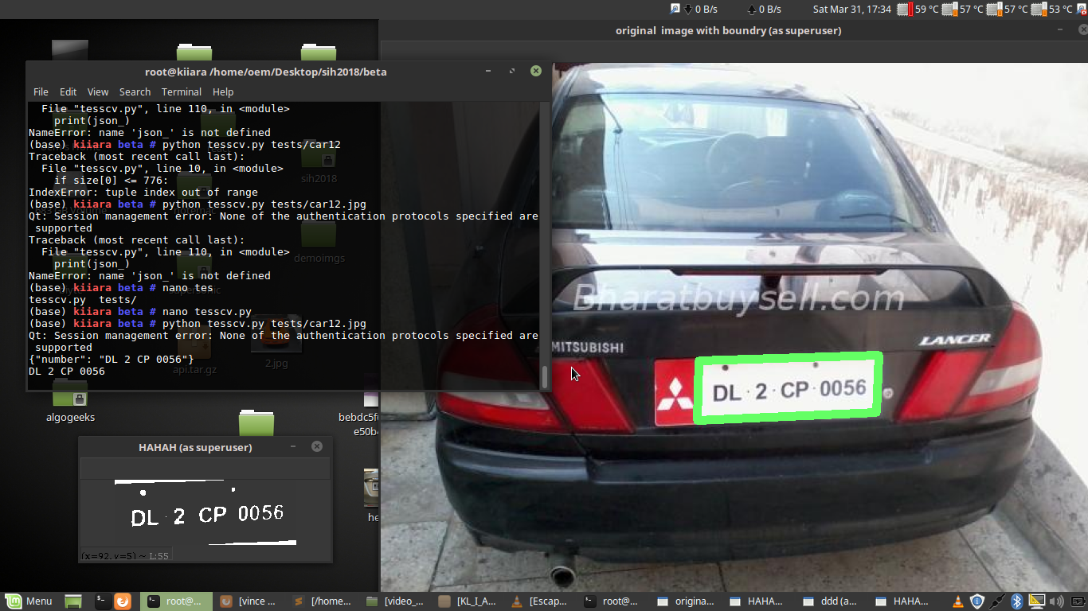
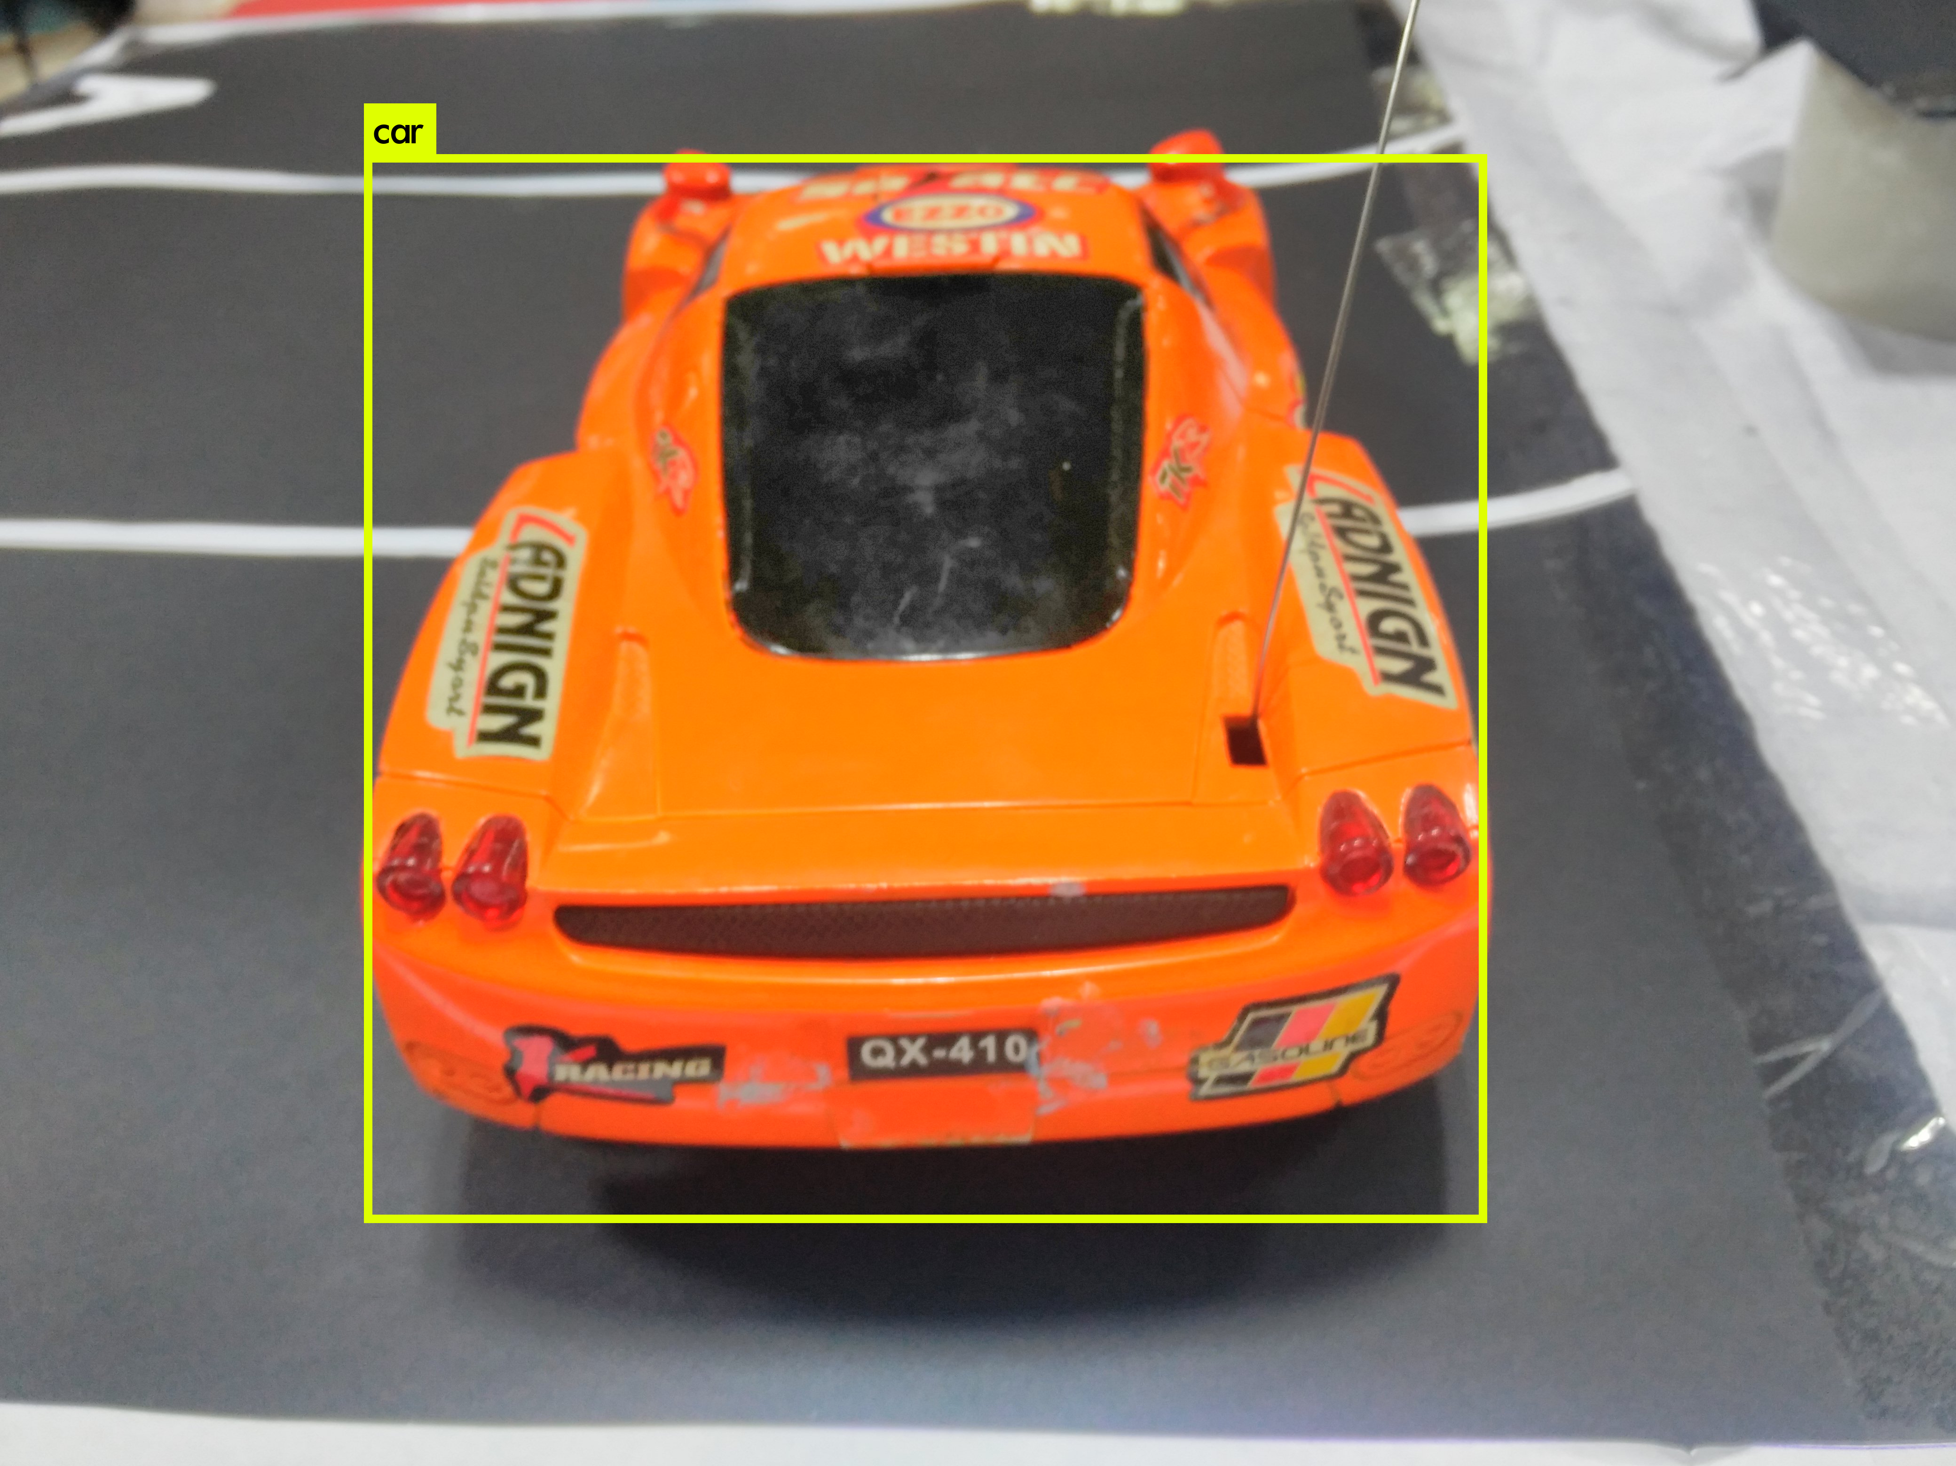
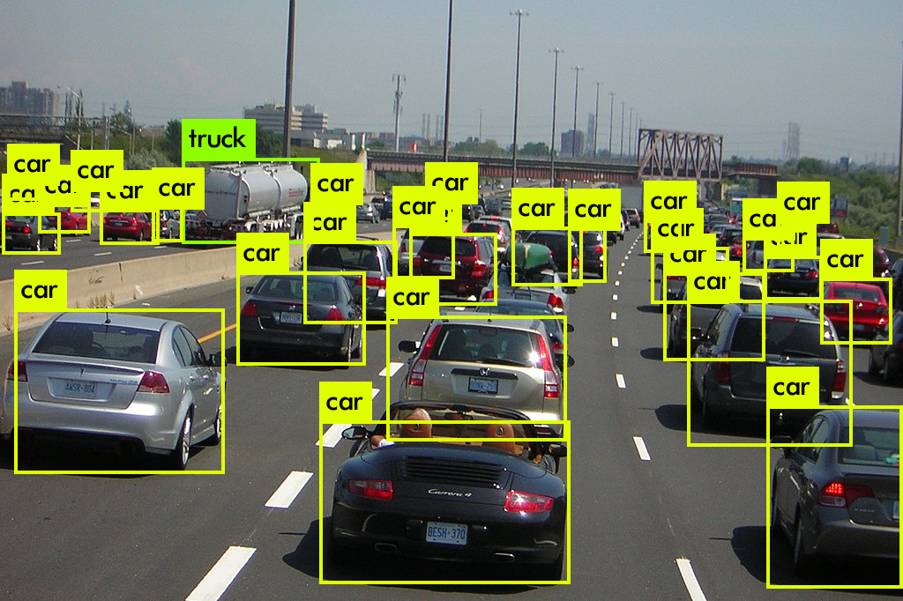
NUMBER PLATE IDENTIFICATION
CAR
DETECTION

Slide 10
COST ESTIMATION FOR INSTALLATION
Cost for IP Camera 2350 x 5 = Rs.11750
(one time setup)
Raspberry pi Rs. 2000
Server cost Rs.1200
Installation charge
plus wiring charge 5000
Total cost – Rs.19950 per year
Total commission of park owner Rs. 2862000
Total commission provided by park owner Rs. 286200
Net profit in a year Rs. 266150
if provided service for 10 parking spaces Rs. 2661500
If invested with amount Rs.199500
Overall profit approx. 24 lakh annually

